Slide 1

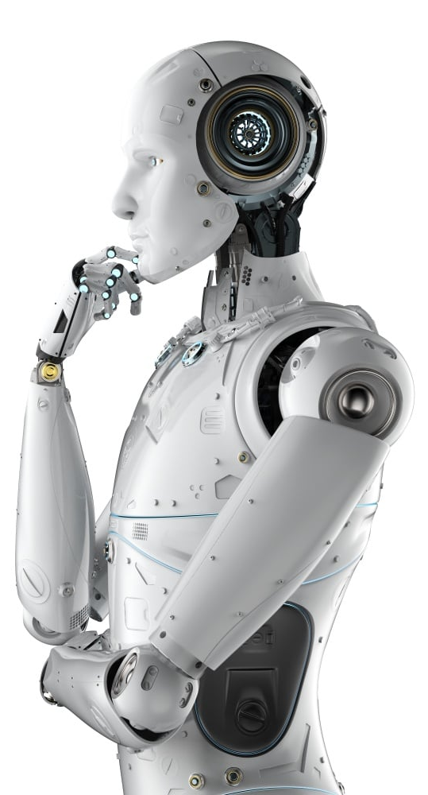
30 Days
Machine Learning
Master Class - தமிழ்
DAY 12 / 30
Exam mark prediction using linear regression

Slide 2
30 Days
Machine Learning
Master Class - தமிழ்
Exam mark prediction using linear regression
DAY 12 / 30

Slide 3
Announcement
NO Attendance link
Be Present in the live session for minimum 70%
Minimum 25 Days Attendance required to receive your FREE E-CERTIFICATE
Join our Community to clarify your doubts

Slide 4
Prerequisites for this Course
Be Ready with sufficient data
Laptop with Good Internet
No basic knowledge is required.
Note & Pen

Slide 5
Ready For Session
Exam mark prediction using linear regression

Slide 6
Ready For Session
Exam mark prediction using linear regression

Slide 7
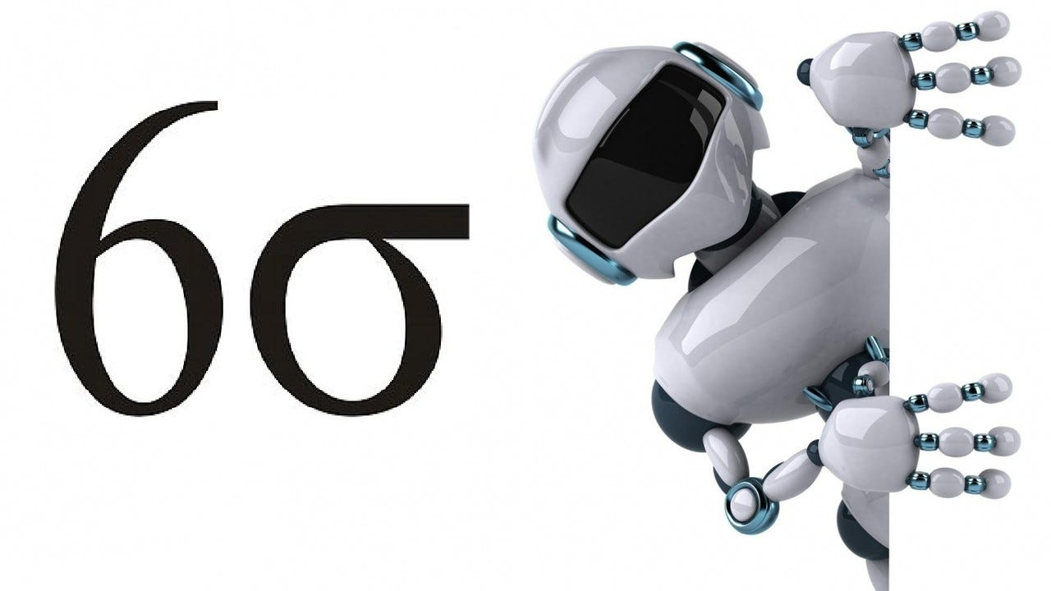
Ready
For
Hands-On
Exam mark prediction using linear regression

Slide 8
Ready
For
Hands-On
Exam mark prediction using linear regression

Slide 9
Mindset of the Day
If you don't learn anything from failure, then that is the real failure…

Slide 10




THANK YOU☺
Join our What’s app Community group
novitechresearchanddevelopment
Join our Community to clarify your doubts

Slide 11
THANK YOU☺
Join our What’s app Community group
novitechresearchanddevelopment
Join our Community to clarify your doubts

